Slide 1
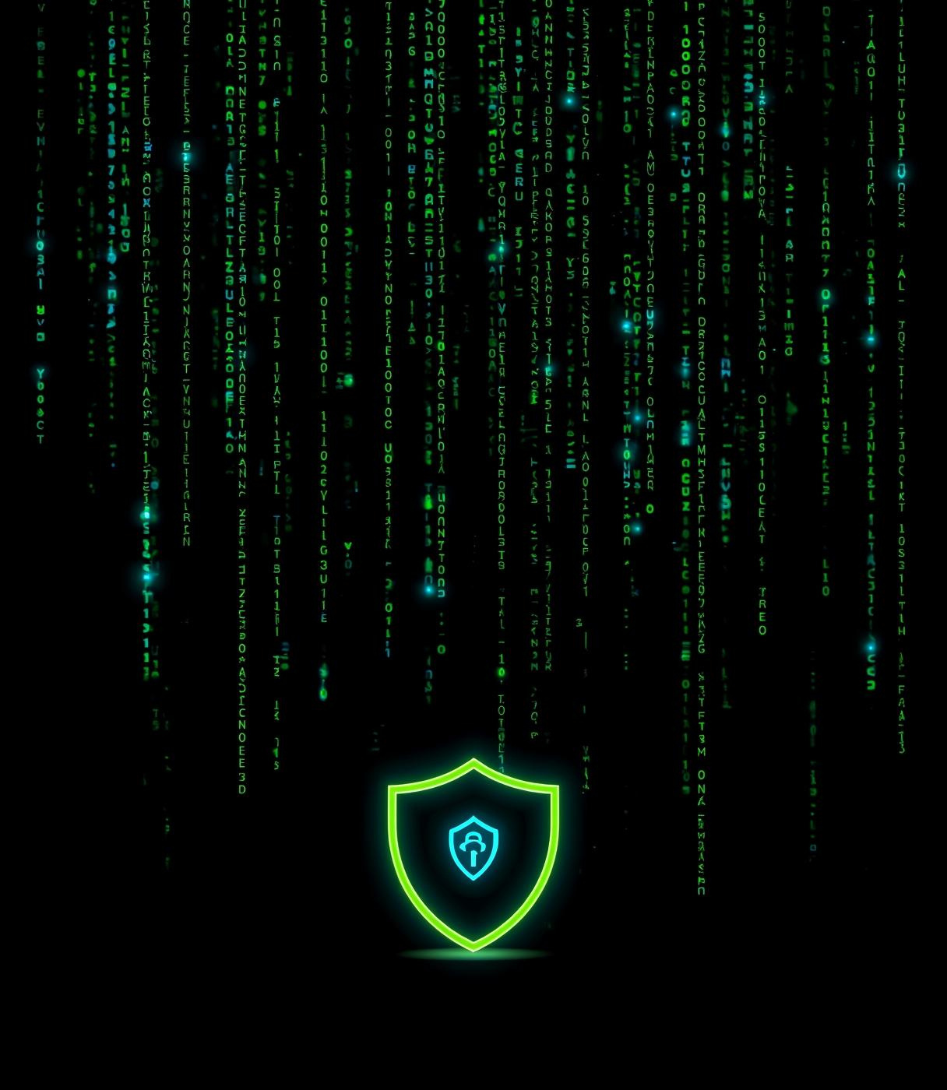

Mandar Kajbaje
Phishing Awareness
BSC CS Student Training
PRESENTED BY
Mandar Kajbaje

Slide 2

What is Phishing?
Phishing is a form of cyber deception where attackers manipulate individuals into revealing sensitive information, often through fake emails or websites designed to appear legitimate.

Slide 3
Types of Phishing Attacks Explained
EMAIL PHISHING
SMISHING
VISHING
Email phishing involves deceptive emails that appear legitimate, aiming to trick recipients into revealing sensitive information or downloading malware. This is one of the most common attack methods.
Smishing utilizes SMS messages to lure victims into providing personal information or clicking malicious links. This technique exploits the trust people place in text messages, often appearing urgent.
Vishing, or voice phishing, involves phone calls where scammers impersonate legitimate entities to extract sensitive data. This tactic relies heavily on manipulating the victim's trust and emotions.

Slide 4
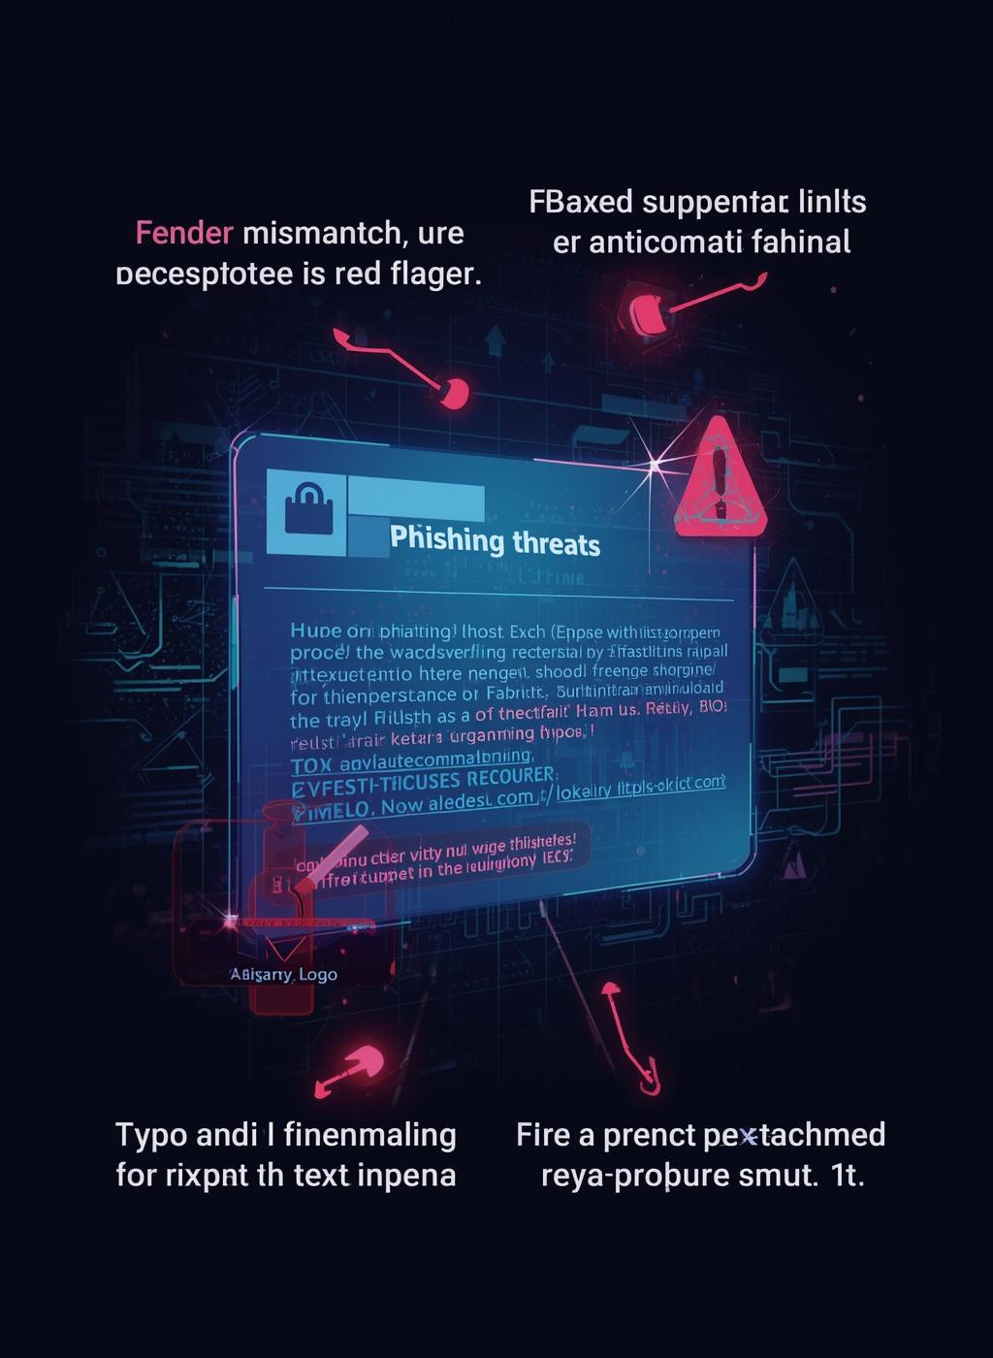
Recognizing Phishing Emails
Identifying phishing emails is crucial for online safety. Look for red flags like sender mismatches, urgency, typos, and suspicious links to protect your data.

Slide 5
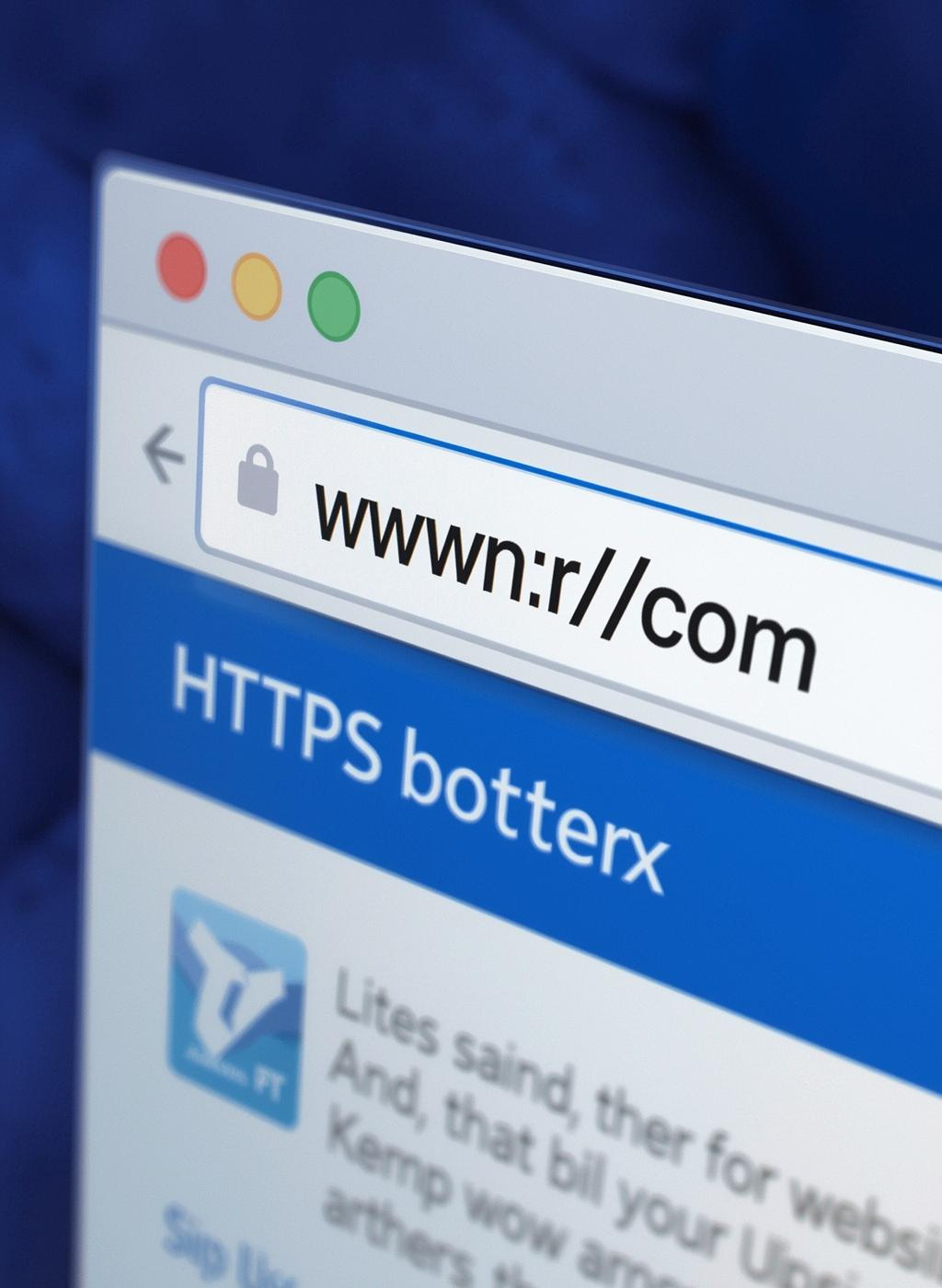
Fake Websites
Recognizing fake websites is crucial in preventing online fraud. Look for URL traps and deceptive practices that can easily lead to data theft and malware.

Slide 6

How Social Engineering Works
Social engineering exploits human psychology to manipulate individuals into divulging confidential information. It leverages emotions like fear, urgency, and trust to achieve its aims.

Slide 7
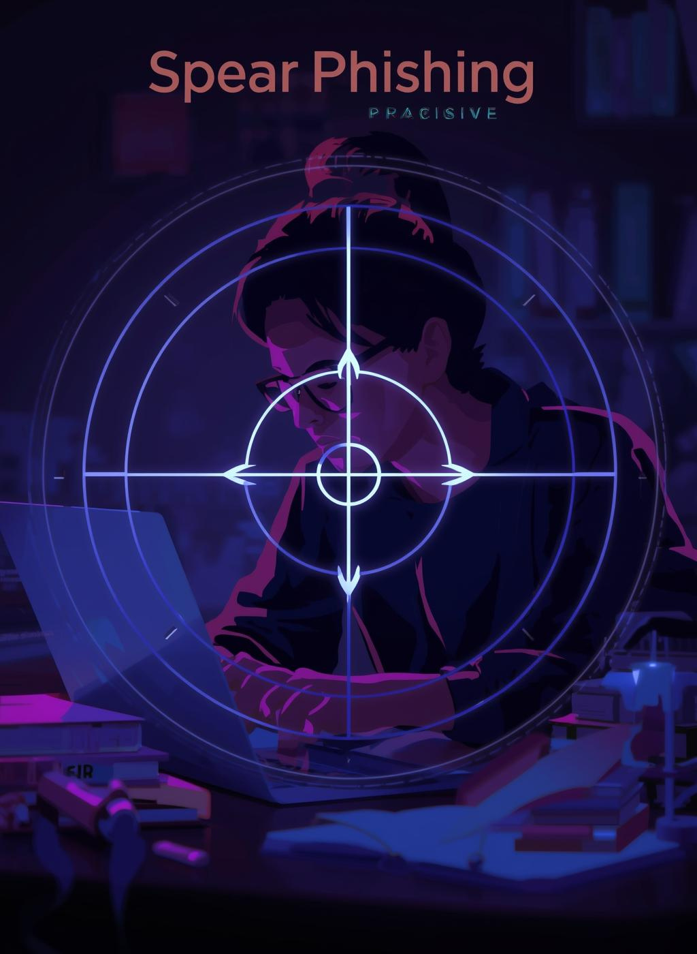
Spear Phishing
Spear phishing targets specific individuals or organizations, using personalized tactics to deceive victims. These attacks often involve custom emails that appear legitimate, making them more dangerous.

Slide 8
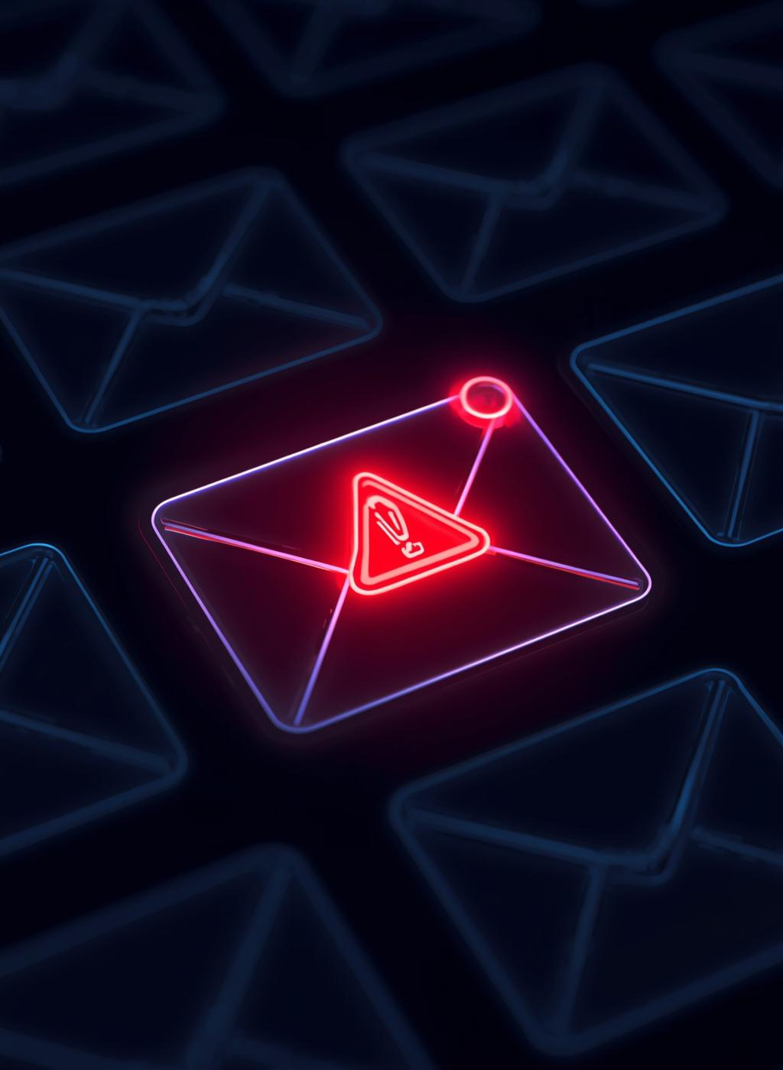
Business Email Compromise
Business Email Compromise (BEC) is a sophisticated scam where attackers impersonate executives to defraud organizations through deceitful emails, often leading to significant financial losses.

Slide 9
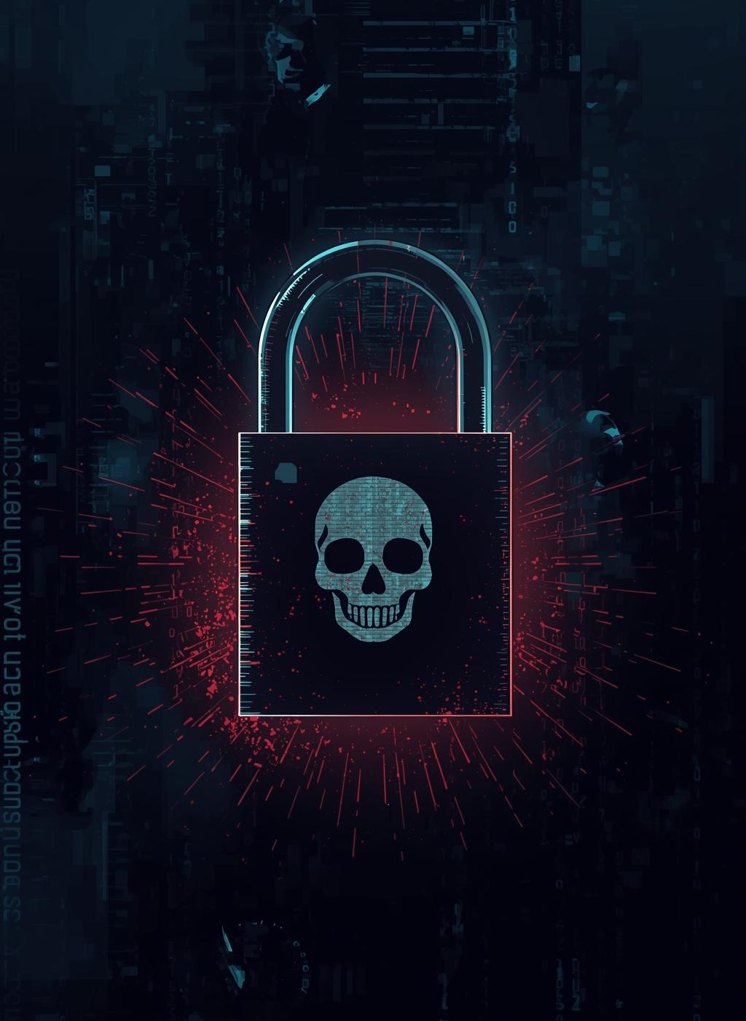
Ransomware Threats
Ransomware delivered through phishing attacks can encrypt critical files, demanding payment for access. Understanding this risk is essential for protecting personal and organizational data from malicious actors.

Slide 10
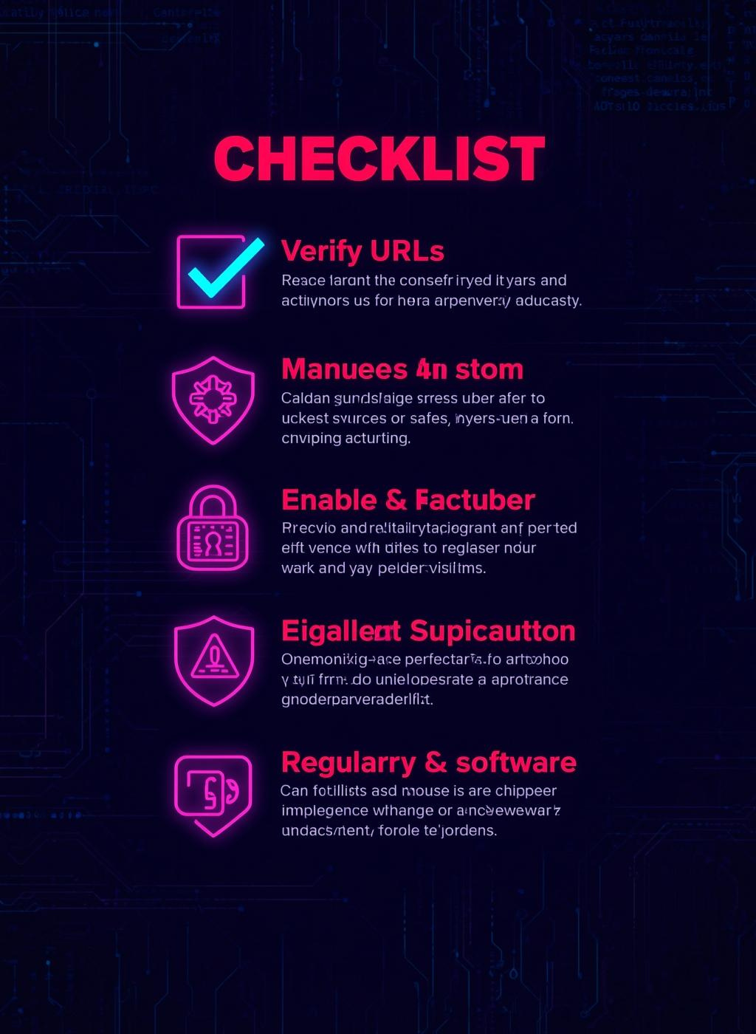
Best Practices
Staying safe online requires vigilance and proactive measures. Familiarize yourself with essential practices to protect against phishing and ensure your digital security effectively.

Slide 11

What to Do
If you clicked on a suspicious link, it's crucial to take immediate action to protect your information and minimize potential damage.

Slide 12
Interactive Quiz
SCENARIO QUESTION 1
SCENARIO QUESTION 2
An email claims you've won a prize. What should you do first?
You receive a call asking for your bank details. What action is best?
SCENARIO QUESTION 3
SCENARIO QUESTION 4
A link directs you to a login page that looks familiar. How do you verify?
You see a message with urgent language demanding immediate action. What’s your response?
SCENARIO QUESTION 5
SCENARIO QUESTION 6
A colleague asks for sensitive information via email. What is your next step?
You clicked a suspicious link. What should you do immediately to stay safe?

Slide 13
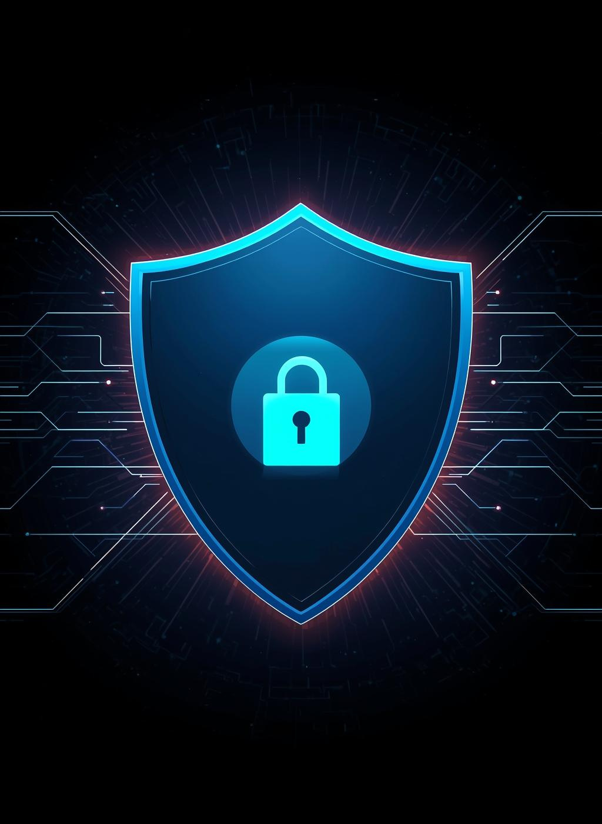
Key Takeaways
Understanding phishing is vital for staying safe online. Remember to stop, think, and verify communications, as awareness and reporting are crucial in combating cyber threats.

Slide 14
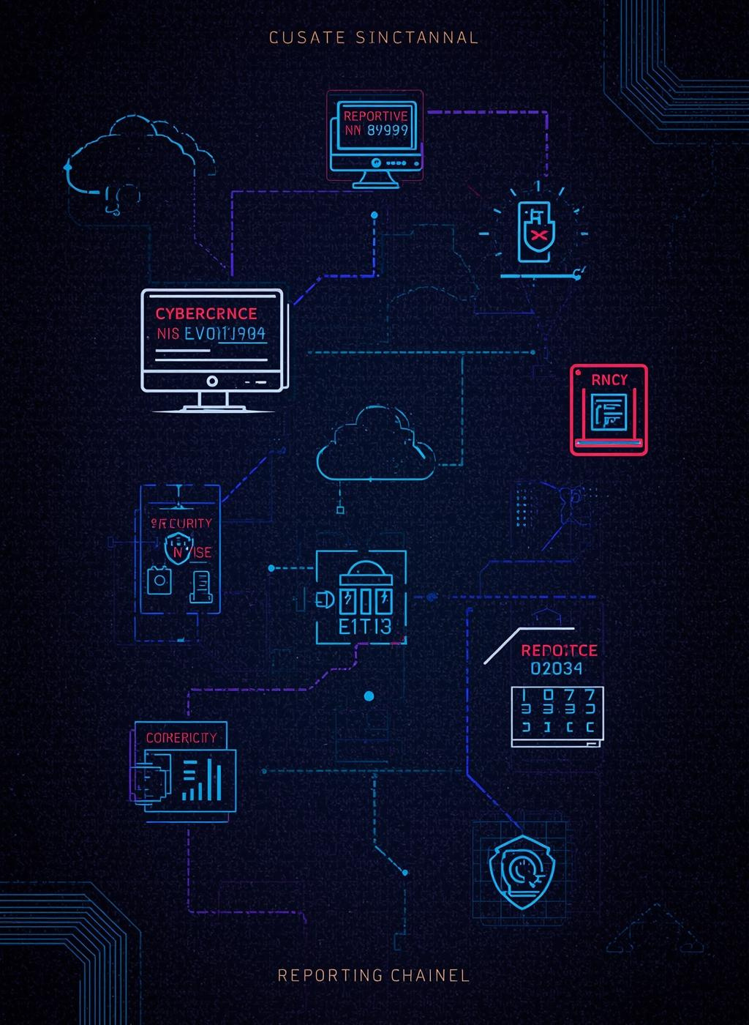
Report Cybercrime
It's essential to report any cybercrime incidents to protect yourself and others. Utilize the official channels for assistance and guidance in handling these threats effectively.

Slide 15
